Slide 1

SWENG 837 Course Project Student: juliane Alvarado salgado

Slide 2
Agenda
INTRODUCTION
Design Solution
Use Case Diagram
Domain Diagram
Activity/Sequence Diagram
Class Diagram
State Diagram
Component Diagram
Cloud Deployment
Architecture
Design Principles & Patterns
Conclusion and Next Steps

Slide 3
Introduction
Project: Build a recommendation engine for a music streaming service that uses machine learning to generate personalized data
Functionalities:
Security and Scalability
Analytics and Algorithms
Customization and Feedback
Global Content and Library
Target Audience:
Music Enthusiasts
Fitness Enthusiasts
Casual Listeners

Slide 4
Introduction cont.
Business Goals:
Customer Satisfaction
Growth
The project solution is designed keeping the following NFR’s in mind:
Load Balancing
Database Optimization
Horizontal and Vertical Scaling
Encryption
Authentication
Containerization
Cross-Platform Compatibility

Slide 5
Design Solution
UML Design Visuals

Slide 6
Problem Statement
Build a recommendation engine for a music streaming service.
Utilize machine learning and user data to recommend personalized content to users.
This recommendation service will analyze user specific search, customization decisions, and feedback to identify predicable behavior and generate personalized content.
Recommendation Engine will also use existing data for the given user demographic (age, location, likes, provided feedback) and compare to others similar to the user to show recommended content.

Slide 7
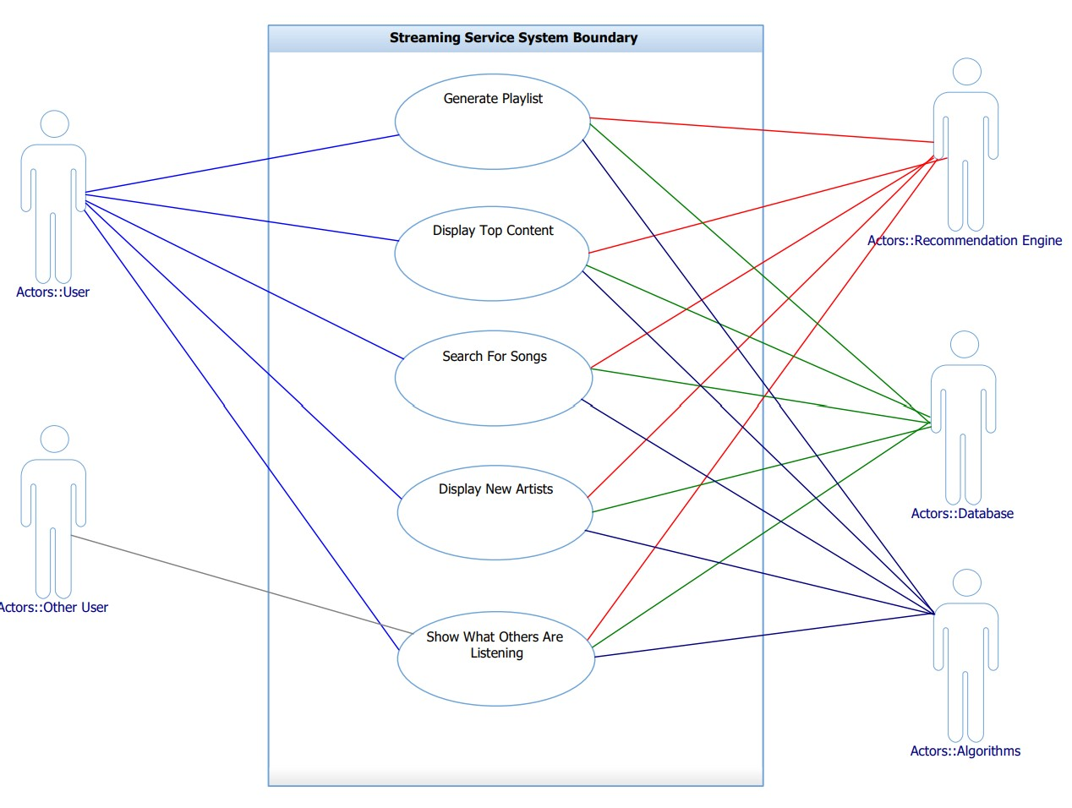
Use Case Diagram
Figure 1 demonstrates the visual representation of the system’s actors (primary, secondary and offstage) and their interaction with the chosen use cases.
Primary Actors: User, Recommendation Engine
Secondary: Other user, Algorithms, Database
Generate Playlist
Display Top Content
Search for Songs
Display New Artists
Show What Others are Listening
Figure 1. Use Case Diagram

Slide 8
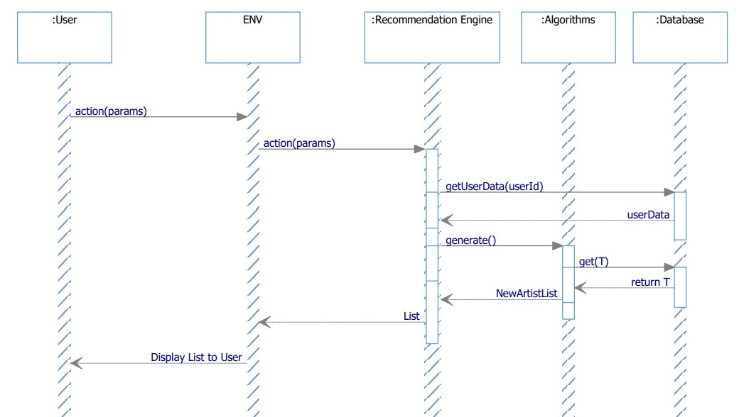
SDD diagram
Figure 2 demonstrates the system sequence diagram that is applicable to all use cases. It is a very high-level diagram showing basic interaction between the actors to the system.
The generic sequence follows:
User takes action.
System is triggered to act and communicates with the Recommendation Engine.
Recommendation engine extracts data from Database and feeds it to the Algorithm.
The algorithm generates the personalized list.
List is displayed to the user.
Figure 2. Generic SDD.

Slide 9
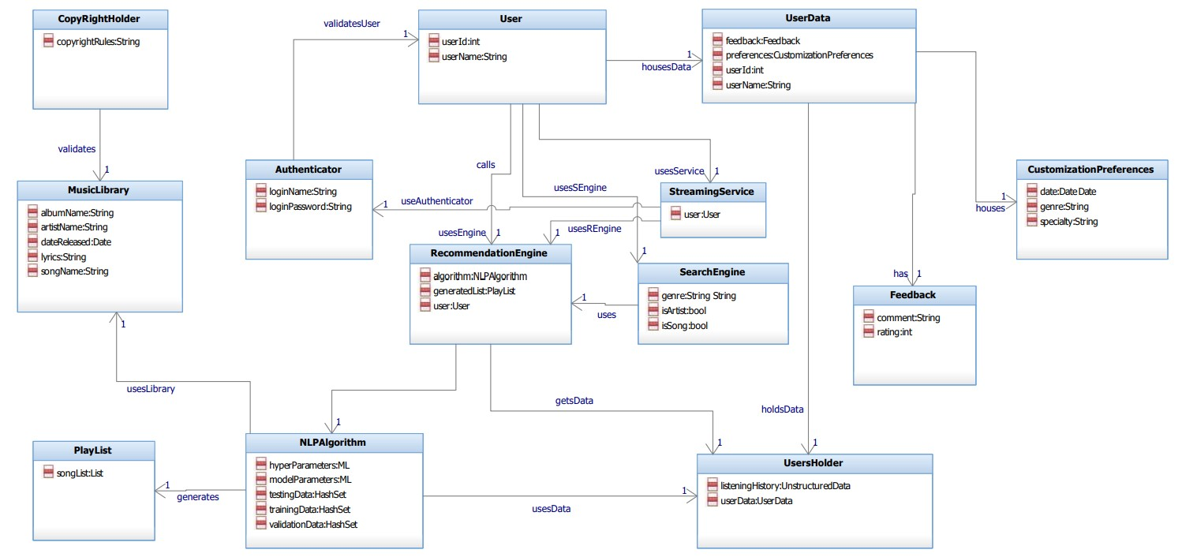
Domain Model
Figure 3. Domain Model.

Slide 10
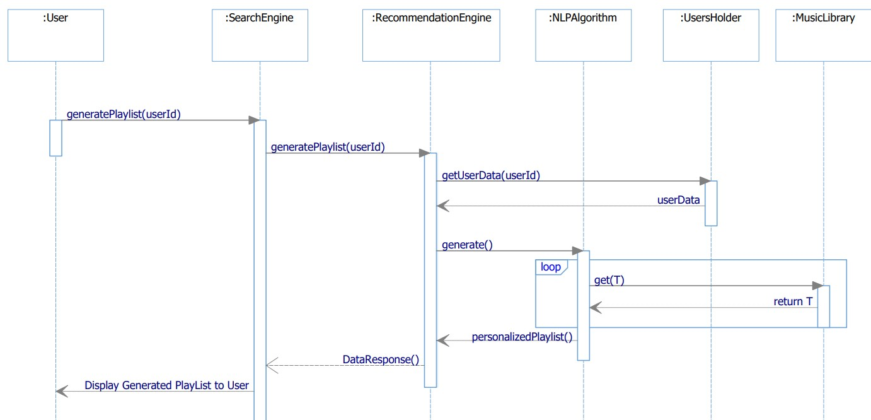
SDD diagram – SOC1
Name Of Operation: | generatePlayList(userId:int)
Responsibilities: | Streaming Service displays recommended playlist to User using the Machine Learning Algorithms.
Type: | System
Cross Reference: | Use Case 1
Exception: | If the database is not available, indicate that there was an error.
Outputs: | System Displays List.
Pre-Conditions | Users’ data already exists in UserHolder; NLPAlgorithm already has a model to generate the desired data.
Post-Conditions: | NLPAlgorithm takes in any feedback from User and uses it enhanced its model.
Figure 4. UC1 SOC Interaction Diagram.

Slide 11
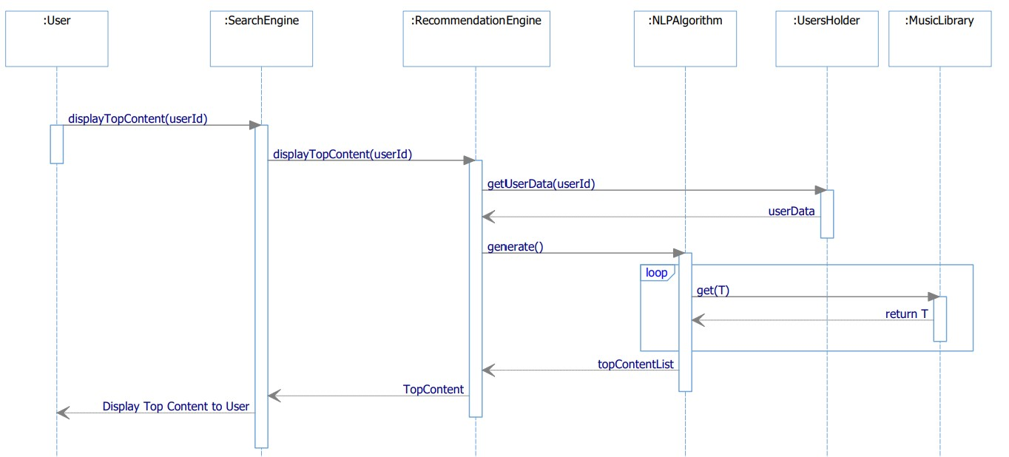
SDD diagram – SOC2
Name Of Operation: | displayTopContent(userId:int)
Responsibilities: | Streaming Service displays users top content List to User using the Machine Learning Algorithms.
Type: | System
Cross Reference: | Use Case 2
Exception: | If database is not available, indicate that there was an error.
Outputs: | System Displays List
Pre-Conditions | Users’ data already exists in UserHolder; NLPAlgorithm already has a model to generate the desired data.
Post-Conditions: | NLPAlgorithm takes in any feedback from User and uses it enhanced its model.
Figure 5. UC2 SOC Interaction Diagram.

Slide 12
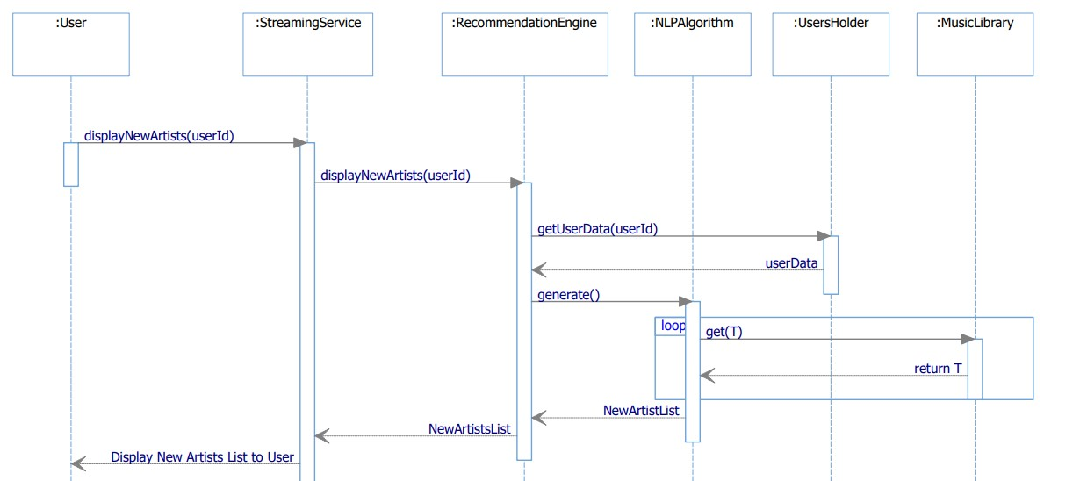
SDD diagram – SOC3
Name Of Operation: | displayNewArtists(userId:int)
Responsibilities: | Streaming Service displays new artists List to User using the Machine Learning Algorithms
Type: | System
Cross Reference: | Use Case 3
Exception: | If database is not available, indicate that there was an error.
Outputs: | System Displays List
Pre-Conditions | Users’ data already exists in UserHolder; NLPAlgorithm already has a model to generate the desired data.
Post-Conditions: | NLPAlgorithm takes in any feedback from User and uses it enhanced its model.
Figure 6. UC3 SOC Interaction Diagram.

Slide 13
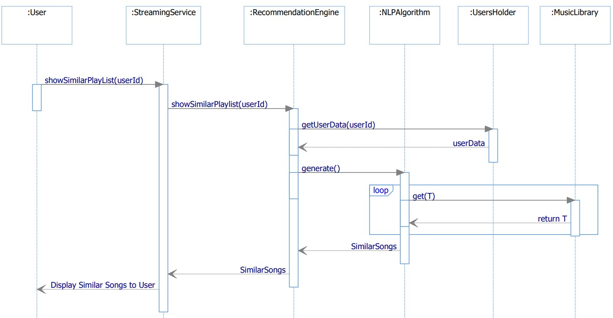
SDD diagram – SOC4
Name Of Operation: | showSimilarPlaylist(userId:int)
Responsibilities: | Streaming Service displays similar playlists from other users to User using the Machine Learning
Type: | System
Cross Reference: | Use Case 4
Exception: | If database is not available, indicate that there was an error.
Outputs: | System Displays List
Pre-Conditions | Users’ data already exists in UserHolder; NLPAlgorithm already has a model to generate the desired data.
Post-Conditions: | NLPAlgorithm takes in any feedback from User and uses it enhanced its model.
Figure 7. UC4 SOC Interaction Diagram.

Slide 14
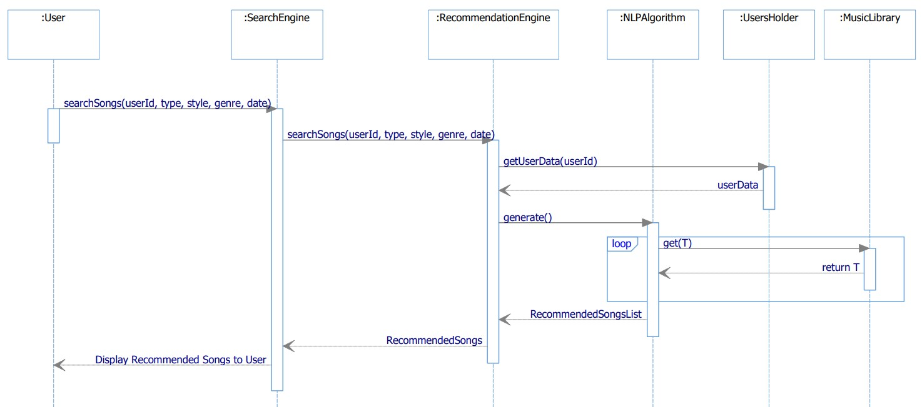
SDD diagram – SOC5
Name Of Operation: | searchSongs(userId:int, type:String, style:String, genre:String, date:Date)
Responsibilities: | Search Service displays Songs to User using the Machine Learning Algorithms.
Type: | System
Cross Reference: | Use Case 5
Exception: | If database is not available, indicate that there was an error.
Outputs: | System Displays List
Pre-Conditions | Users’ data already exists in UserHolder; NLPAlgorithm already has a model to generate the desired data.
Post-Conditions: | NLPAlgorithm takes in any feedback from User and uses it enhanced its model.
Figure 8. UC5 SOC Interaction Diagram.

Slide 15
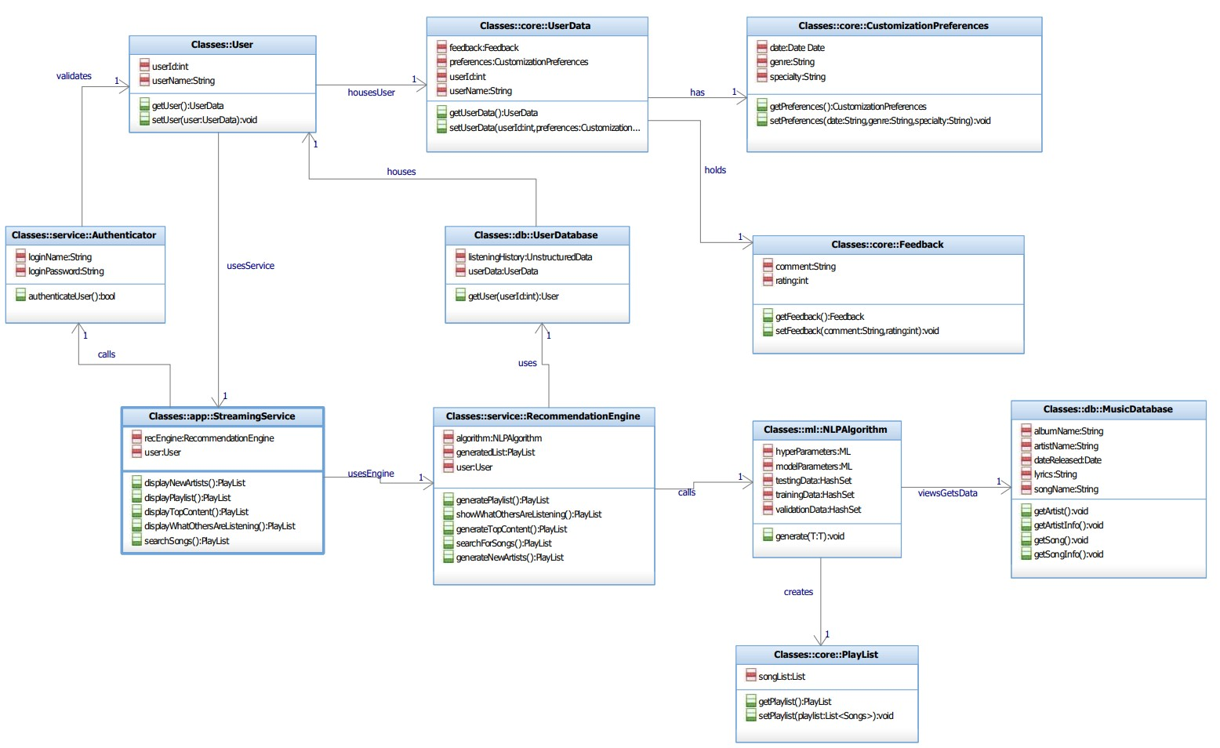
Class Diagram
Figure 9. Class Diagram

Slide 16
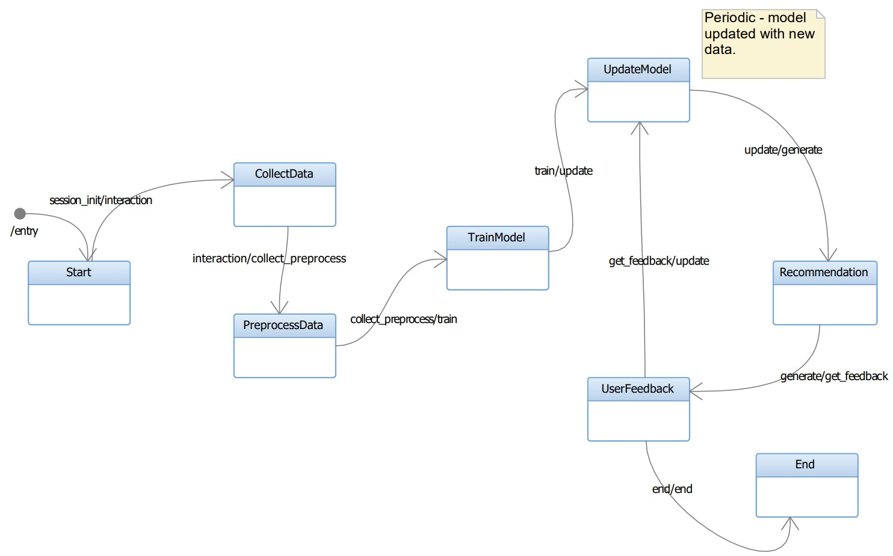
State diagram​
Figure 10. State Diagram

Slide 17
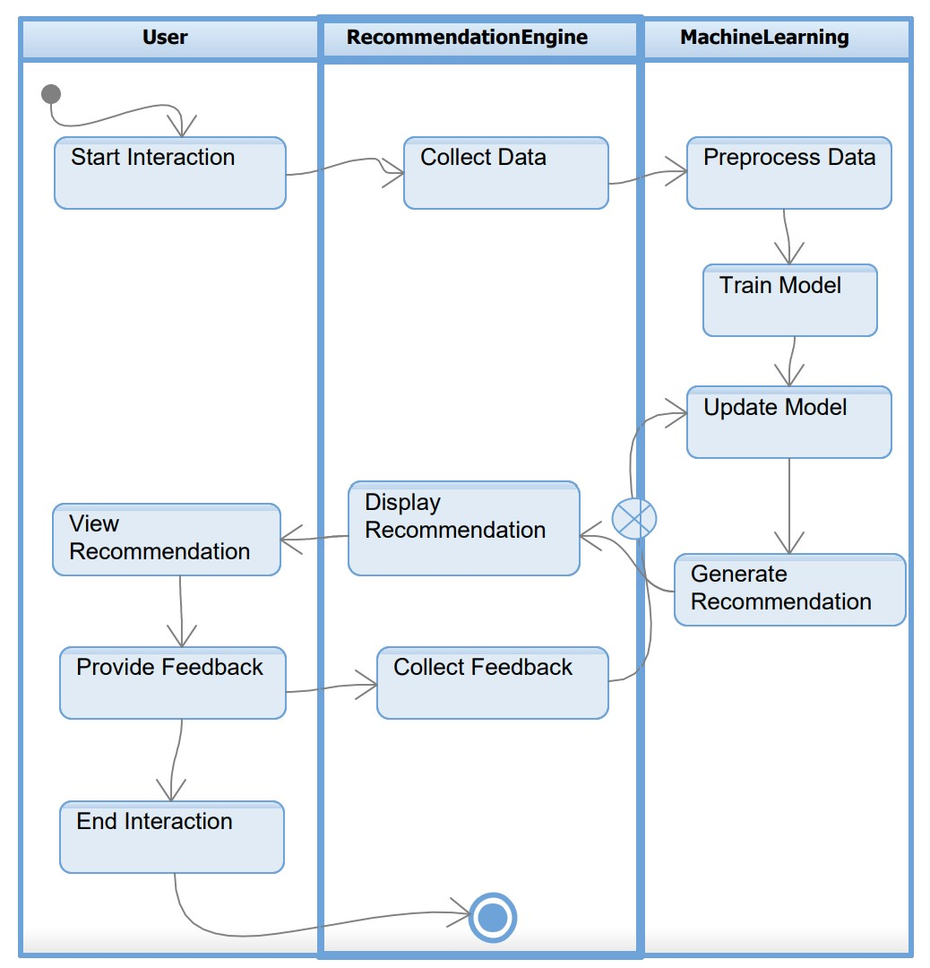
Activity diagram
Figure 11 visually represent the activities and flows within the recommendation engine system, highlighting the responsibility of different actors using swim lanes.
Figure 11. Activity Diagram

Slide 18
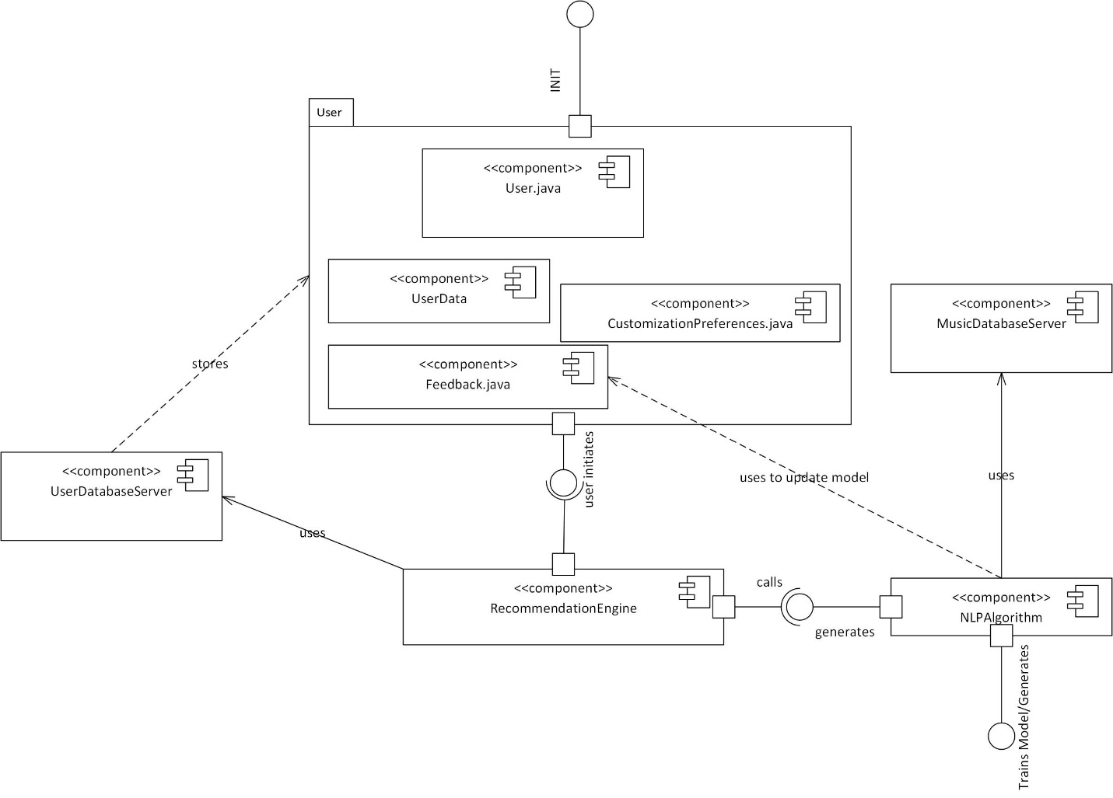
Component Diagram
Figure 12 depicts the system's physical components and their dependencies, providing a high-level architectural view.
Figure 12. Component Diagram

Slide 19
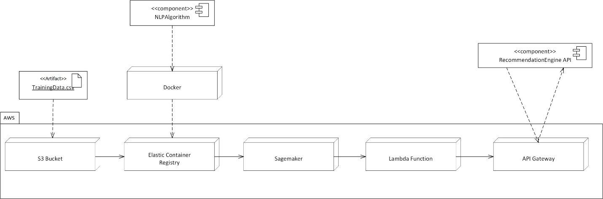
Deployment Diagram
Figure 13. Cloud Deployment Diagram
An ML pipeline is created using AWS tools. The service will be deployed through an API that can receive HTTP requests and use the machine learning model to make predictions and generate personalized music streaming data for user. Below are the tools:
The NLPAlgorithm will use python libraries such as Pandas for the ML algorithm.
Docker will be used for containerizing the algorithm.
Amazon S3 for storing datasets and the trained model.
Amazon ECR for hosting custom algorithm in the Docker container.
Amazon Sagemaker for training models and making predictions using the Docker Container.
AWS Lambda Function for invoking Sagemaker Endpoint to deploy the model, and enriching response.
API Gateway for pushing the public API service to the Internet.

Slide 20
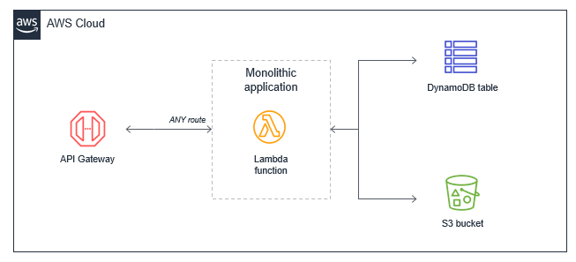
Architecture pattern​
Cloud-Native Applications
Speed, Safety, and Scalability
Containerization and Orchestration
Monolithic System
System has a simple Architecture
Figure 14. Monolithic System in AWS¹

Slide 21
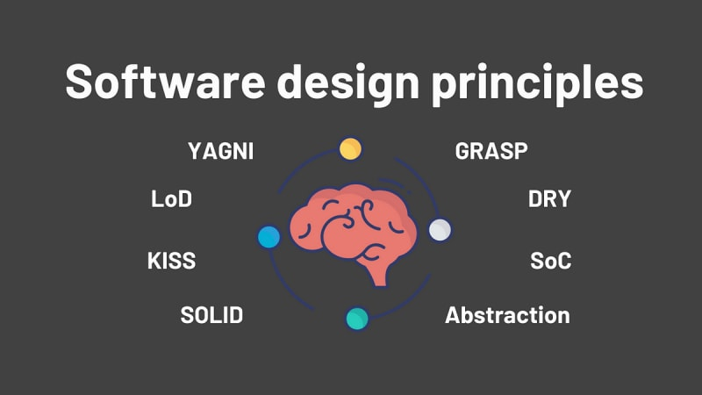
Design principles & patterns
Keep It Simple, Stupid (KISS)
Maintainability
Scalability
Clarity
Focus on core functionalities
Provide clean and prioritized recommendation
Figure 14. Software Design Principles

Slide 22
Conclusion and next steps
Key takeaways:
Shape Project and Set Boundaries – expectations and scope boundaries are defined and helps uncover major issues and uncertainties.
Start Small and then extend - John Gall: “A complex system that works is invariably found to have evolved from a simple system that worked.”

Slide 23
THANK YOU

